Slide 1

空白演示
English 118: IRP Presentation
Student: Zhan Yu
Instructor: T. Nuckolls
单击输入您的封面副标题
Topic: Teenage Obesity

Slide 2

空白演示
Backgroud information
Severe problems to teenager's body condition and mental health
Heart disease, Diabetes
Hypertention
Psychological problems
单击输入您的封面副标题

Slide 3

空白演示
Backgroud information
Economic Burden
$190 billion on obesity treatment
$14 billion on childhood obesity
单击输入您的封面副标题
(Jackson, 2019)

Slide 4
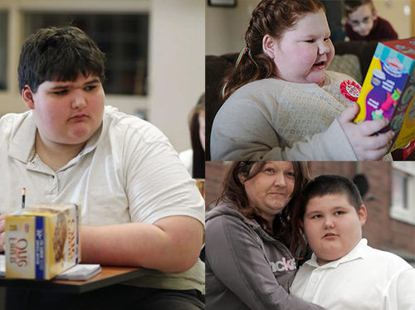
空白演示
RQ: How can society best reduce rate of teenage obesity in U.S.
单击输入您的封面副标题

Slide 5
空白演示
Thesis: Although using medicine and undergoing bariatric surgery have each been suggested as a solution to the problem of American teenage obesity, the most workable solution is improving the living habits of children and teenagers.
P1: Medicine
P3: Living habits improvement
leading a well-organized life
单击输入您的封面副标题
P2: Bariatric surgery

Slide 6
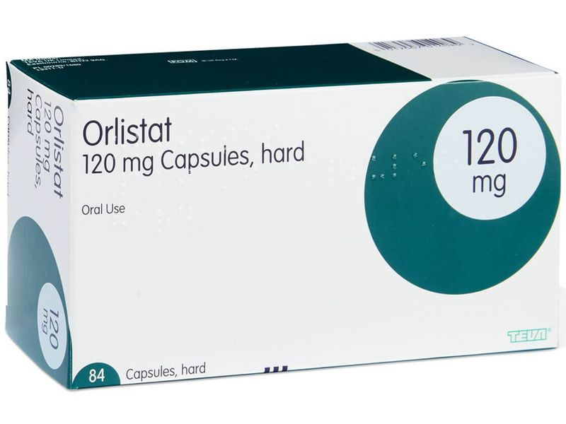
空白演示
Point 1: Using medicine
Orlistat
A. lost 0.35 kg and lost 2.53 kg of fat > placebo(0.6kg)(Chanoine et al., 2005).
B. Maintained two-thirds of their weight loss (Davidson, 1999).
单击输入您的封面副标题

Slide 7

空白演示
Counterargument to Point 1
A. Limited kinds of medicine: Orlistat and metformin (Apovian, 2016).
B. Regain weight & lost only 5.56 kg/2 years (J. Capella and R. Capella, 2003).
单击输入您的封面副标题

Slide 8

空白演示
Point 2: Bariatric Surgery
A. Effects last longer by enhanced satiety(Apovian, 2016).
B. 70% ~ 80% complications resolved (Black, 2013).
单击输入您的封面副标题

Slide 9
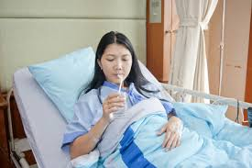
空白演示
Counterargument to Point 2
A. Limitations: Substance abuse(Inge et al., 2004).
B. Post-bariatric surgery care. (Apovian, 2016).
单击输入您的封面副标题

Slide 10
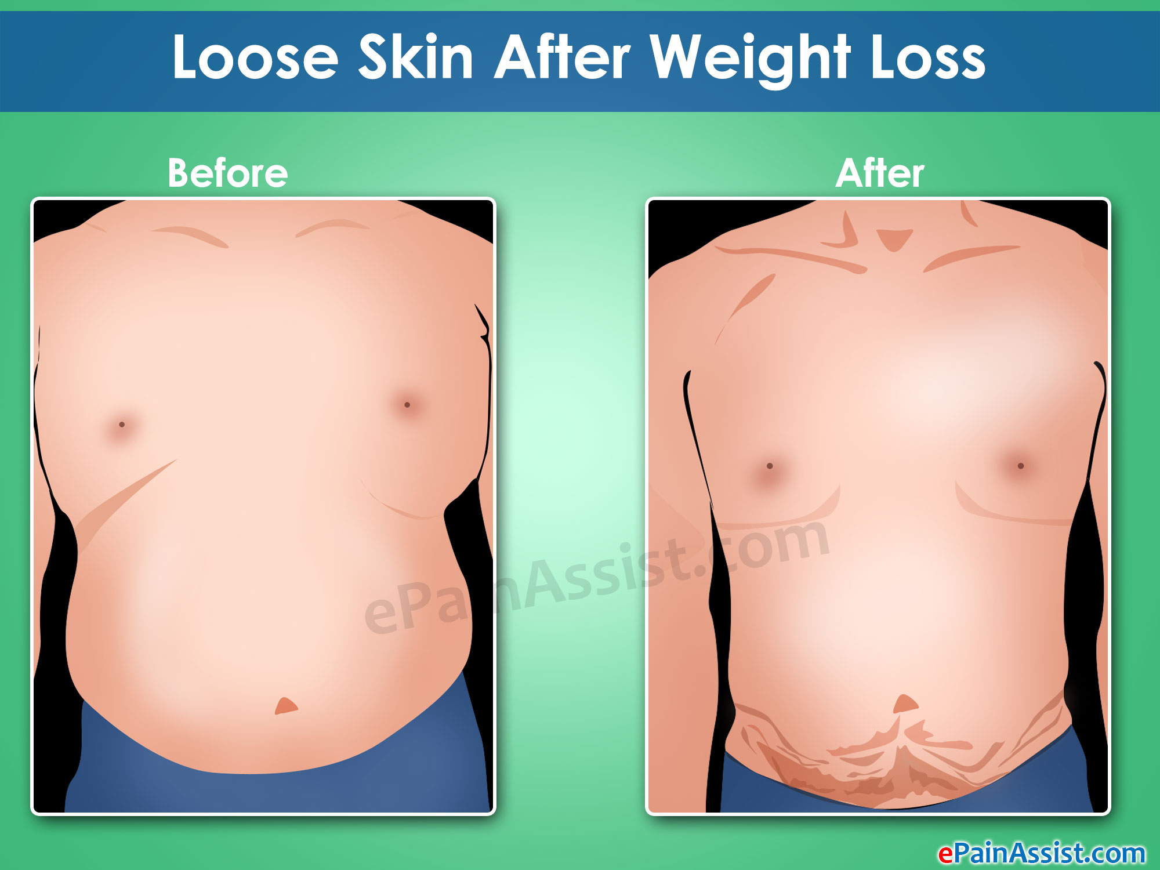
空白演示
Counterargument to Point 2
Psychological effects: appearance -- excess skin
Less confidence
Plastic surgery -- scars and stretch marks
(J. Capella and R. Capella, 2003)
单击输入您的封面副标题

Slide 11
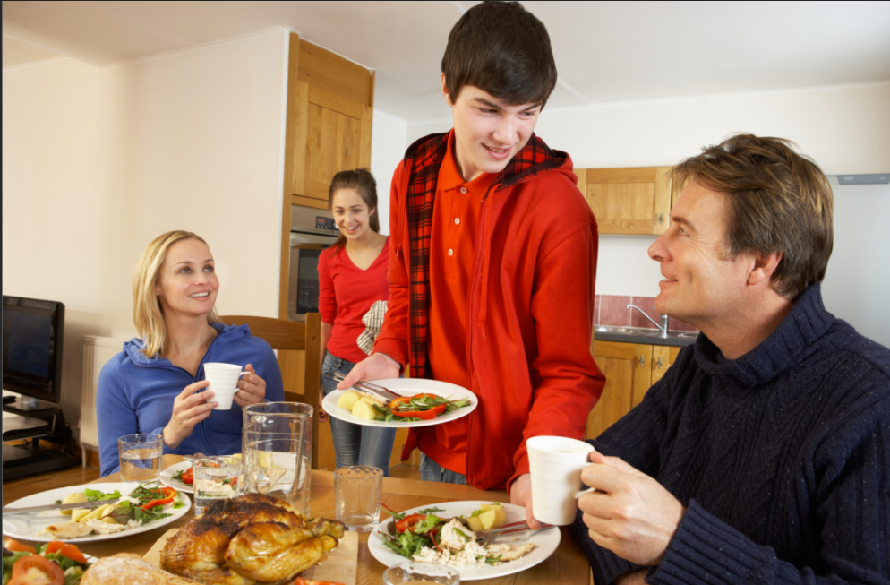
空白演示
Point 3: Improving living habits
Healthier diet
A. Very low calorie diets (VLCD) & Protein saving fast diets (PSMF) (Zwiauer, 2000).
B. Better than using medicine (Davidson et al.,1999)
单击输入您的封面副标题

Slide 12
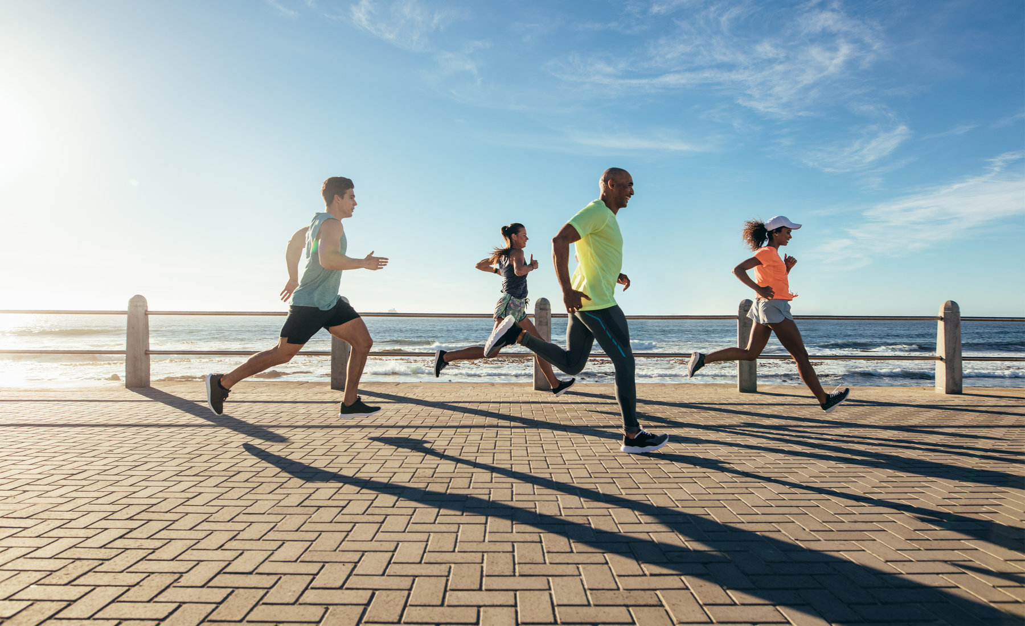
空白演示
Point 3: Improving living habits
Exercise
A. Inactive teens (Zwiauer, 2000).
B. Aerobic exercise reduce fat (Jackson et al., 2019)
C. Better experience:
More enjoyable when exercising in a cohesive environment (Wilson et al., 2012).
Become compliant with exercise (Oliveira et al., 2016).
单击输入您的封面副标题

Slide 13
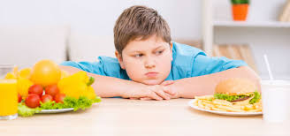
空白演示
Point 3: Improving teenager's living habits
Improvement of children's living habits
A. Obesty not abate (Jackson et al., 2019).
B. 50% to 80% carry obesity with severe diseases (Inge et al., 2004).
单击输入您的封面副标题

Slide 14
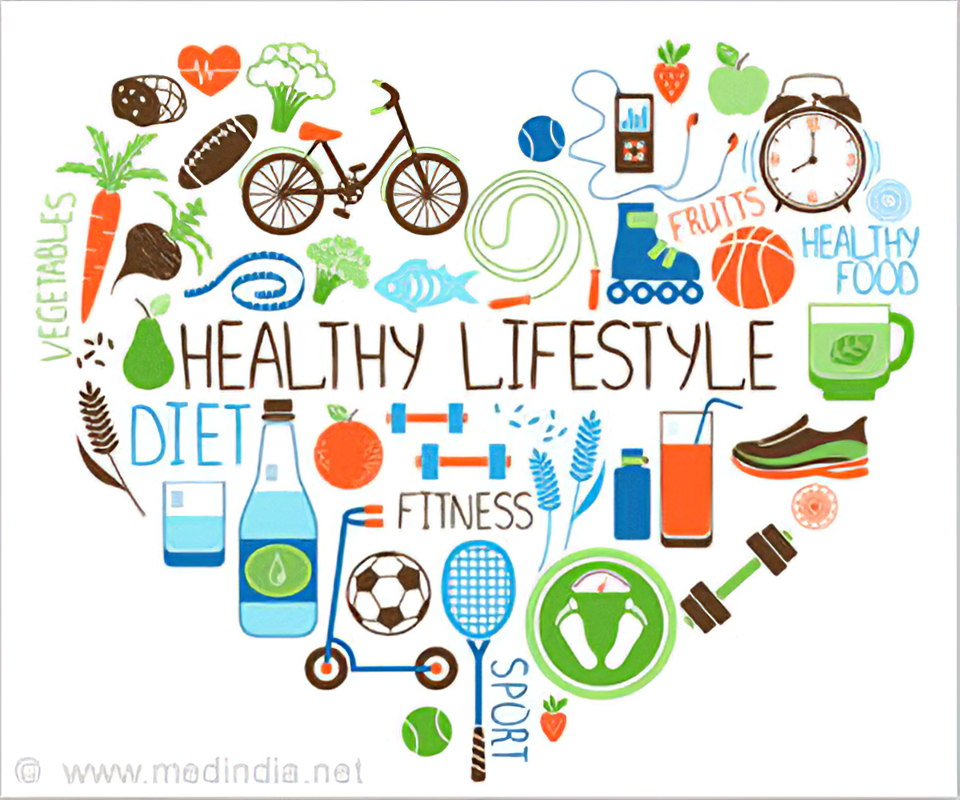
空白演示
Conclusion
American society should reduce teenage obesity rate by improving living habits of both teenagers and children.
单击输入您的封面副标题

Slide 15
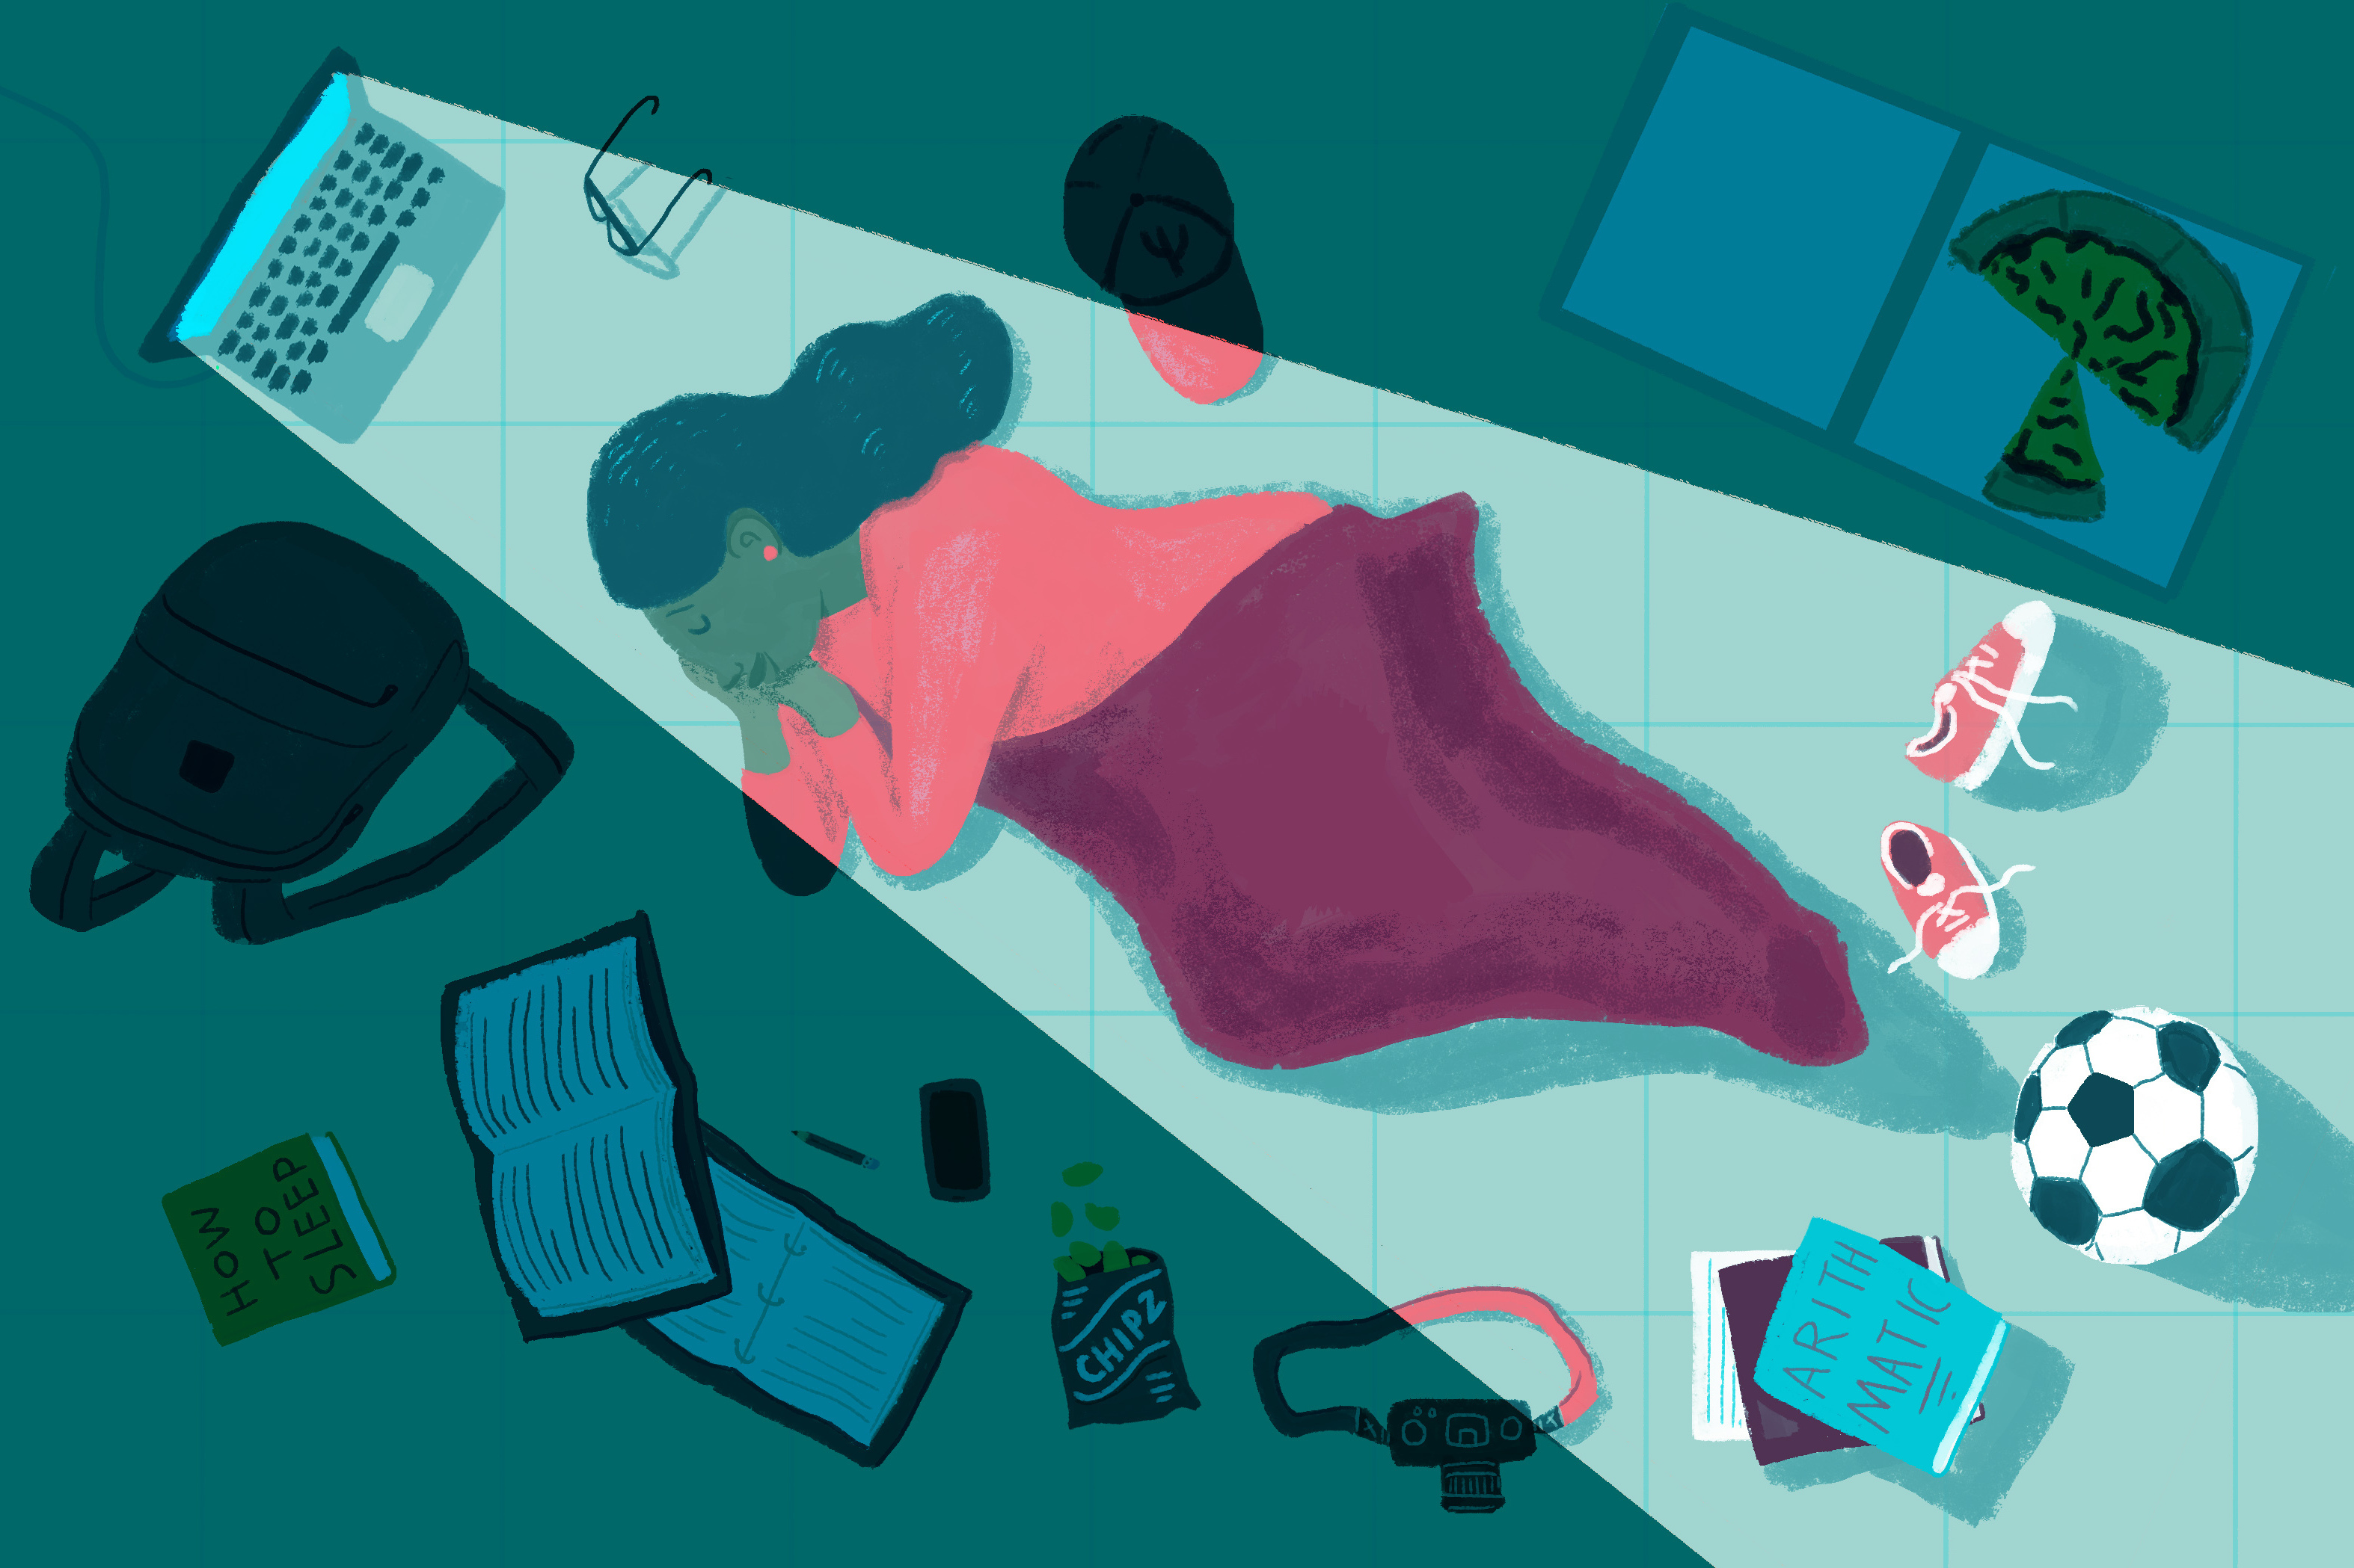
空白演示
单击输入您的封面副标题
Q & A

Slide 16

空白演示
单击输入您的封面副标题

